Slide 1


Embedded AVR Workshop
Session
2
C Programming

Slide 2



Hello!
Instructor: Abd-El Wadoud Ahmad (MTI, CS)
abdelwadoud299@gmail.com
Instructor: Marwan Alaa
marwan3laaosman@gmail.com

Slide 3
QR Code Placed Here

Slide 4


Content
C Introduction
Breaking “Hello World”
Data Types & Operators
Memory
If & Switch Statements
For & While Loops
Bitwise Operations
Git & GitHub

Slide 5

C How to Program Quick History Mother of all Programming Languages

Slide 6

What’s Programming?
Dictionary: the process or activity of writing computer programs.
Coursera: refers to the act of using different languages to communicate with and instruct computers
W3School: is telling a computer what to do.

Slide 7
History of Programming
1949
1991
Assembly Language
-Kathleen Booth
Python
-Guido van Rossum
1883
1972
2006
Algorithm for the Analytical Engine
-Ada Lovelace
C
-Dennis Ritchie
Rust
-Graydon Hoare

Slide 8
So why C?
General-Purpose Programming Language (GPL) Not Domain-Specific Programming Language (DSL)
Imperative Procedural Language (Programming Paradigm) Not Declarative Functional
Statically Typed Not Dynamically Typed
Efficiency, Direct Hardware Interaction
Low-level Programming, Real-time Operations

Slide 9
printf(“Hello World”); Basic Programming Every Programmer’s First Program

Slide 10
Printing “Hello World”
#include <stdio.h>
int main() {
printf("Hello World!");
return 0;
}
<-- Library
<-- Main function
<-- Statement
<-- Exit Program

Slide 11
Data Types Declaration & Initialization How to story your values?

Slide 12
What are Data Types & Variables
A Variable is a named storage in memory that holds data
A Data Type specifies what kind of value a variable can hold
C provides primitive types which are:
int represents an integer number
float represents a
char represents a one character or word
bool represents a unary either true or false value

Slide 13
Data Types
Data Type | Size | Description | Format Specifier | Example
int | 2 or 4 bytes | Stores whole numbers | %d or %i | 3
float | 4 bytes | Stores fractional numbers. Sufficient for storing 6 decimal digits | %f or %F | 3.2
double | 8 bytes | Stores fractional numbers. Sufficient for storing 15 decimal digits | %lf | 3.22222222
Char | 1 byte | Stores a single character, following ASCII values | %c or %s (string) | ’w’

Slide 14
Extended Types
Extend Type | Size | Range | Format Specifier
int | 2 or 4 bytes | -32768 to 32767 (2bytes) Or -2,147,483,648 to 2,147,483,647 (4bytes) | %d or %i
unsigned int | 2 or 4 bytes | 0 to 65,535 (2 bytes) Or 0 to 4,294,967,295 (4bytes) | %u
short int | 2 bytes | -32,768 to 32,767 | %hd
long int | 4 or 8 bytes | -2,147,483,648 to 2,147,483,647 (4 bytes) Or -9,223,372,036,854,775,808 to 9,223,372,036,854,775,807 (8 bytes) | %ld

Slide 15
The Cure <stdint.h>
Data Type | Size | Range
uint8_t | 1 byte | 0 .. 255
int8_t | 1 byte | -128 .. 127
uint16_t | 2 bytes | 0.. 65535
uint32_t | 4 bytes | 0 .. 4,294,967,295

Slide 16
Declaration & Initialization
#include <stdint.h>
#include <stdio.h>
void main() {
int value = -32
float pi = 3.14
char grade = 'B'
uint8_t counter = 255;
uint16_t timer_value = 1000;
uint64_t XL = 18446744073709551615;
}

Slide 17
What about string?
C provides Primitive Types, but string is not a primitive type
The hidden truth: string is actually stored as an array of characters
Why? in other languages string is provided with flexible storage that can increase depending on the length, but that costs more memory storage with hidden allocations which C isn’t made for

Slide 18
Memory Memory Layout Looking deep into memory rooms!

Slide 19
Memory
C provides direct control over memory management
The compiler reserves a number of bytes depending on the type
We need to access memory (RAM) to store a specific value of a variable in or data

Slide 20
Memory
int X = 5;
char Flag = 'A';
Memory Address | RAM | Variable | Data Type
0x000001 | 8-Bits | X | Int
0x000002 | 8-Bits | X | Int
0x000003 | 8-Bits | X | Int
0x000004 | 8-Bits | X | Int
0x000005 | 8-Bits | Flag | Bool

Slide 21
Operators Arithmetic, Comparison, And Logical Let’s turn a computer to a calculator

Slide 22
Operators: Arithmetic
Operator | Name | Example
+ | Addition | 2 + 3 = 5
- | Subtraction | 39 – 23 = 16
* | Multiplication | 10 * 10 = 100
/ | Division | 100 / 10 = 10
% | Modulus | 16 % 15 = 1
++ | Increment | 100++ = 101
-- | Decrement | 68-- = 67

Slide 23
Operators: Comparison
Operator | Name | Example
== | Equal | 3 == 3
!= | Not Equal | 3 != 4
> | Greater than | 4 > 3
< | Less than | 3 < 4
>= | Equal or Great than | 4 >= 3
<= | Equal or Less than | 3 <= 3

Slide 24
Operators: Logical
Operator | Name | Example
&& | AND | x < 5 && x < 10
|| | OR | x < 5 || x < 4
! | NOT | !(x < 5 && x < 10)

Slide 25
Operators: Assignment
To assign a value to any variable, we use equal ‘=‘
By combining Equal with any operator from Arithmetic or Logical we get assignment operators with properties of other operator
i.e. x /= 3 is the same as x = x / 3
Basically, a shorter way of writing Assignments

Slide 26
Operators in practice
void main() {
uint8_t x = 7;
uint8_t y = 30;
uint8_t z;
z = x % y;
printf("x %% y = %d\n", z);
z = x > y;
printf("x > y = %d\n", z);
z = x && y;
printf("x && y = %d\n", z);
}
x % y = 7
x > y = 0
x && y = 1

Slide 27
Conditionals Control Flow If you do then good, else then bad

Slide 28
If Statement
Use if to specify a block of code to be executed, if a specified condition is true
Use else to specify a block of code to be executed, if the same condition is false
Use else if to specify a new condition to test, if the first condition is false
Use switch to specify many alternative blocks of code to be executed

Slide 29
What if we demonstrate?
void main() {
int age = 30;
if (age < 18) {
printf("You are a school student.\n");
} else if (age >= 18 && age < 24) {
printf("You are a university student.\n");
} else {
printf("You are a graduate.\n");
}
}

Slide 30
Nested If
int age = 30;
if (age < 18) {
if (age < 13) {
printf("You are a child.\n");
} else {
printf("You are a teenager.\n");
}
} else {
printf("You are an adult.\n");
}
You can also place an if statement inside another if. This is called a nested if statement.
A nested if lets you check for a condition only if another condition is already true

Slide 31
How does Switch work?
switch (day) {
case 1:
printf("Monday");
break;
case 2:
printf("Tuesday");
break;
case 3:
printf("Wednesday");
break;
default:
printf("Invalid day");
}
The value of the expression is compared with the values of each case
If there is a match, the associated block of code is executed
The break statement breaks out of the switch block and stops the execution
The default statement is optional, and specifies some code to run if there is no case match

Slide 32
Loops Loops Loops

Slide 33
What is a loop?
Loops can execute a block of code as long as a specified condition is true.
Loops are handy because they save time, reduce errors, and they make code more readable.

Slide 34
While
while (1) {
printf("Hello, World!\n");
}
The while loop repeats a block of code as long as a specified condition is true

Slide 35
Do While
do {
printf("Hello, World!\n");
} while (0);
This loop will execute the code block once, before checking if the condition is true, then it will repeat the loop as long as the condition is true.

Slide 36
For
for (int i = 0; i < 10; i++) {
printf("Hello, World!\n");
}
When you know exactly how many times you want to loop through a block of code, use the For loop instead of a while loop:

Slide 37
Bitwise Operations Bit Manipulation Getting to know about bits more

Slide 38
What’s special about bitwise operators?
Bitwise operators allows us to manipulate individual bits (0s & 1s), so they only work on integers
We use bit wise operators to talk to the CPU to control specific register
But to understand bitwise operators we need to know logic gates

Slide 39
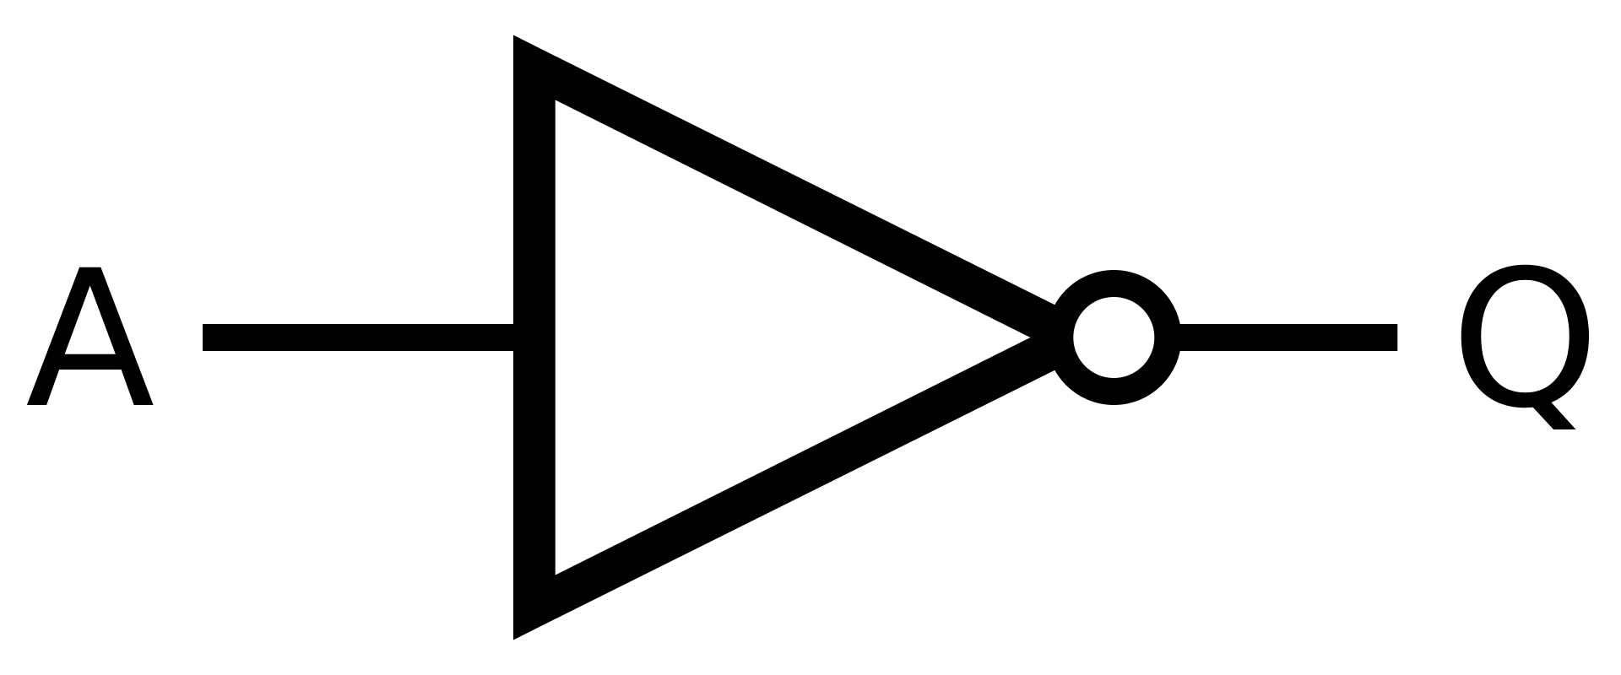
Logic Gates: NOT
The NOT gate (also called Inverter) can transform a signal (or in our case a bit) to the opposite value
A = 0
Q = 1

Slide 40
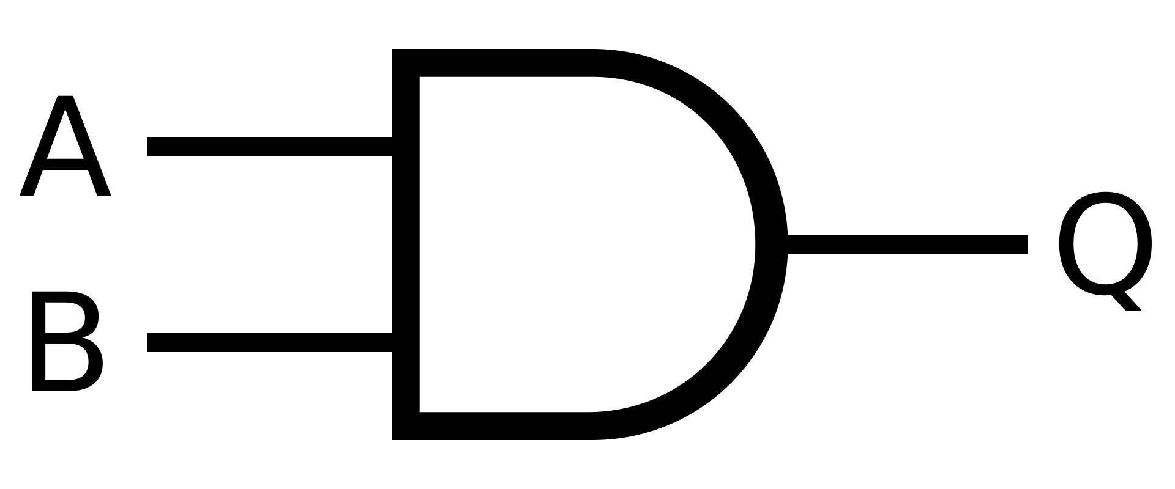
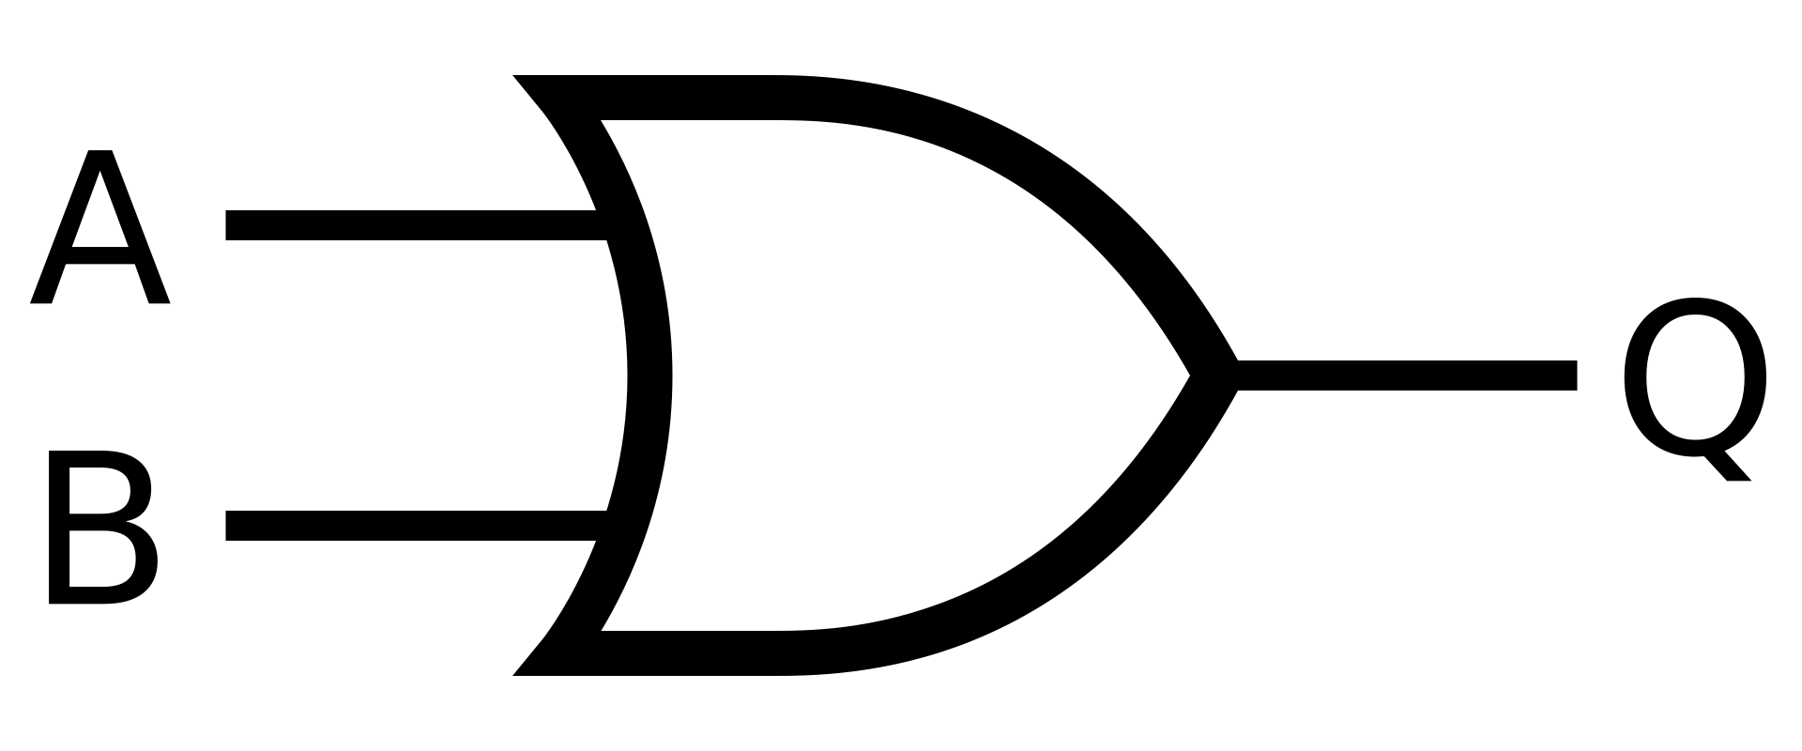
Logic Gates: AND & OR
The AND gate passes down the signal only if both inputs are true
The OR gate passes down the signal only if one of the inputs is true
A | B | Q
0 | 0 | 0
1 | 0 | 0
0 | 1 | 0
1 | 1 | 1
A | B | Q
0 | 0 | 0
1 | 0 | 1
0 | 1 | 1
1 | 1 | 1

Slide 41
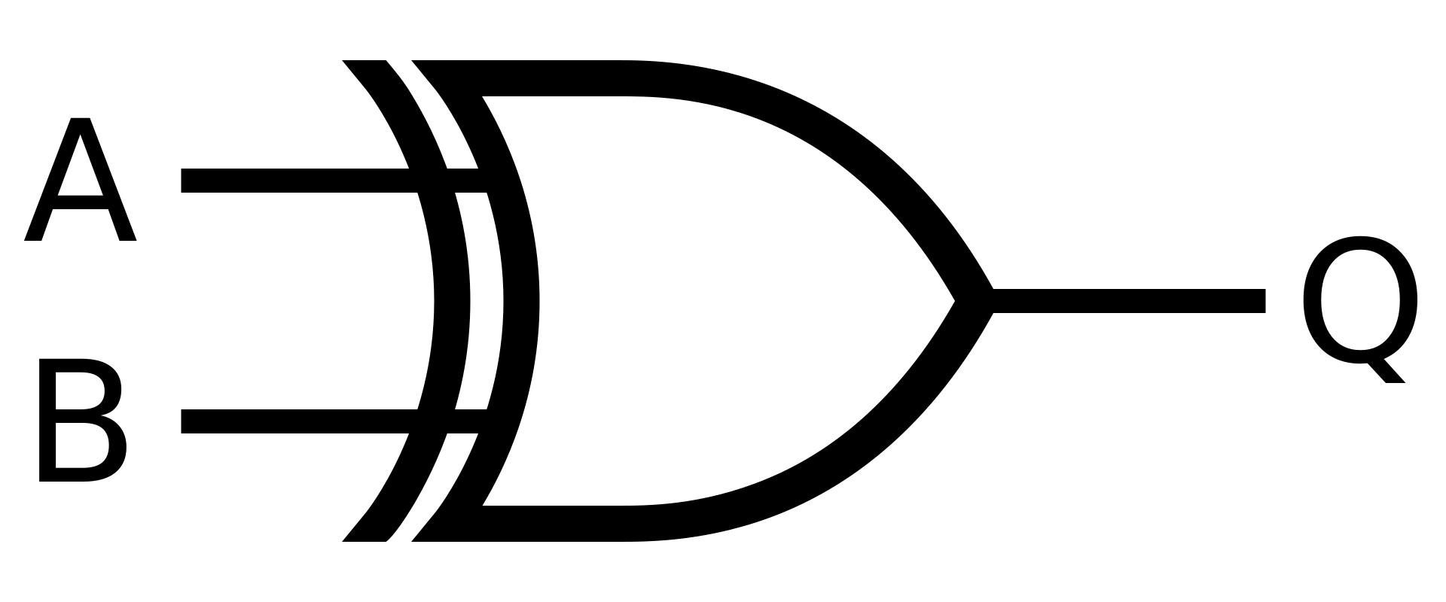
Logic Gates: XOR
The XOR gate passes down the signal only if both inputs are different
A | B | Q
0 | 0 | 0
1 | 0 | 1
0 | 1 | 1
1 | 1 | 0

Slide 42
Bitwise Operators in C
Operator | Name | Example
& | AND | C = A & B
| | OR | C = A | B
^ | XOR | C = A ^ B
~ | NOT | C = A ~ B
>> | Right Shift | C = A >> N
<< | Left Shift | C = A << N

Slide 43
Shift Right and Left
An integer is represented by a set of bits
The shift operators allow to move bits either right or left
Example | A | A before in binary | A after in binary | A after
C = A << 2 | 5 | 0011 | 1100 | 12
C = A >> 2 | 5 | 0011 | 0000 | 0
C = A << 1 | 8 | 1000 | 0000 | 1000
C = A >> 1 | 8 | 1000 | 0100 | 4

Slide 44
A quick task appears!
Now that we know how bitwise operators work
We going to ask you to make 2 functions:
SetBit(): It turns a specific bit true in an integer
ClearBit(): It turns a specific bit false in an integer
int functionName(int integer_value, int bit_position) {
int answer;
//Write your code here
return (answer);
}

Slide 45
SetBit()
int SetBit(int x, int position) {
int answer;
answer = x | (1 << position);
return answer;
}

Slide 46
ClearBit()
int ClearBit(int x, int position) {
int answer;
answer = x & ~(1 << position);
return answer;
}

Slide 47
GitHub Version Control Managing Your Projects

Slide 48
What’s Version Control?
the task of keeping a software system consisting of many versions and configurations well organized
Version control systems help developers keep a complete code history by tracking changes
Examples: Git, Subversion, Mercurial

Slide 49
Git Vs GitHub
the task of keeping a software system consisting of many versions and configurations well organized
Version control systems help developers keep a complete code history by tracking changes
Examples: Git, Subversion, Mercurial

Slide 50
Repository
the fundamental storage location for all the files, code, and the entire revision history for a single project
It functions as a centralized digital "project folder" where individuals or teams can store, manage, and collaborate on work.

Slide 51
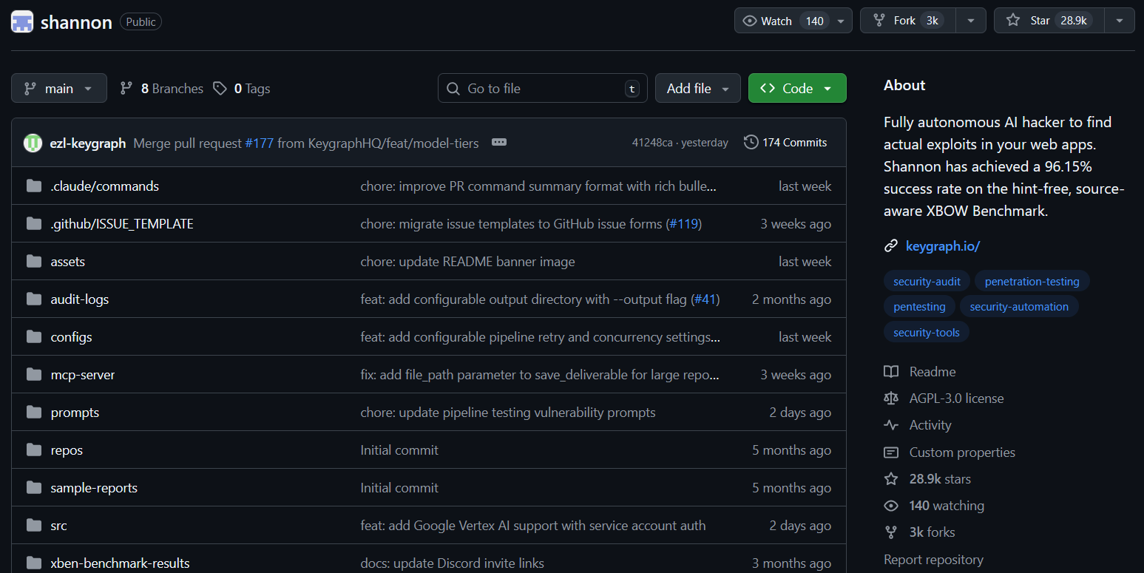
Repository

Slide 52
Important commands for a project
These are commands you are going to use frequently:
git init: Navigate to the project folder and tell Git to start watching it
git add file.c: Tell Git which files to include in the next "save."
git commit –m “A few new lines”: Create a permanent save point with a descriptive message.

Slide 53
Assignment for home!
Create a task2.c file, and write the function for ToggleBit()
Make a GitHub account:
Make a repository called “IEEE Embedded System Tasks”
Upload your task2.c to said repository

Slide 54
Thank You!
Any questions?

